Slide 1

BASELINE ASSESSMENT OF ANTIMICROBIAL STEWARDSHIP PRACTICES AT NAKURU COUNTY REFERRAL AND TEACHING HOSPITAL, KENYA
DR. LYDIA MOMANYI
CLINICAL PHARMACIST & AMS FOCAL PERSON
NAKURU COUNTY REFERRAL & TEACHING HOSPITAL

Slide 2
BACKGROUND
Antimicrobial resistance (AMR) has emerged as a leading public health threat
Estimated 10 million deaths per year by 2050 due to AMR
Antimicrobial Stewardship (AMS) is among the strategies to curb AMR and preserve the effectiveness of antimicrobials
Hospitals with limited AMS programs contribute to AMR - empirical prescribing, inadequate microbiological testing, poor adherence to treatment guidelines
The Antibiotic Stewardship Programme through Innovation, Research, and Education (ASPIRE) - a phased approach, starting with a baseline assessment of antibiotic stewardship practices
Notes:
Hospitals with limited antimicrobial stewardship (AMS) programs contribute significantly to AMR through empirical prescribing, inadequate microbiological testing, and poor adherence to treatment guidelines

Slide 3

Background
NCRTH is an 800-bed capacity level 5 facility
Formerly Rift Valley Provincial General Hospital (RVPGH)
Serves neighbouring 7 counties – Nyandarua, Bomet, Baringo, Kajiado, Kericho, Laikipia & Narok
AMS committee established in 2020 meets regularly every month
Recently established Nakuru CASIC

Slide 4
METHODS
A mixed-methods study, encompassing:
Retrospective patient file reviews of 378 patients
Healthcare worker Knowledge, Attitudes, and Practices (KAP) surveys
Economic evaluation (costing)
WHO AMS functionality assessment- a self-scoring tool was used to establish the functional status of the AMS at NCRTH
Notes:
A mixed-methods study, encompassing:
Retrospective patient file reviews of 378 patients previously admitted in the medical, surgical, obstetrics and gynecology, internal medicine, pediatric wards, and intensive care unit in the past 3 months.
Healthcare Worker Knowledge, Attitudes, and Practices (KAP) surveys
Economic evaluation (costing)
WHO AMS functionality assessment- a self-scoring tool was used to establish the functional status of the AMS at NCRTH

Slide 5
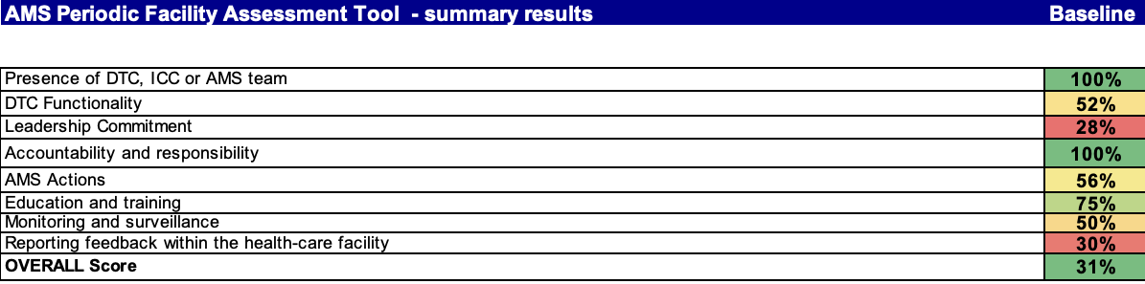
Key Findings – AMS Functionality assessment
AMS functionality at NCRTH was limited, with a score of 31%, need for strengthening
Leadership commitment was the weakest area, opportunity to strengthen governance and support for AMS activities

Slide 6
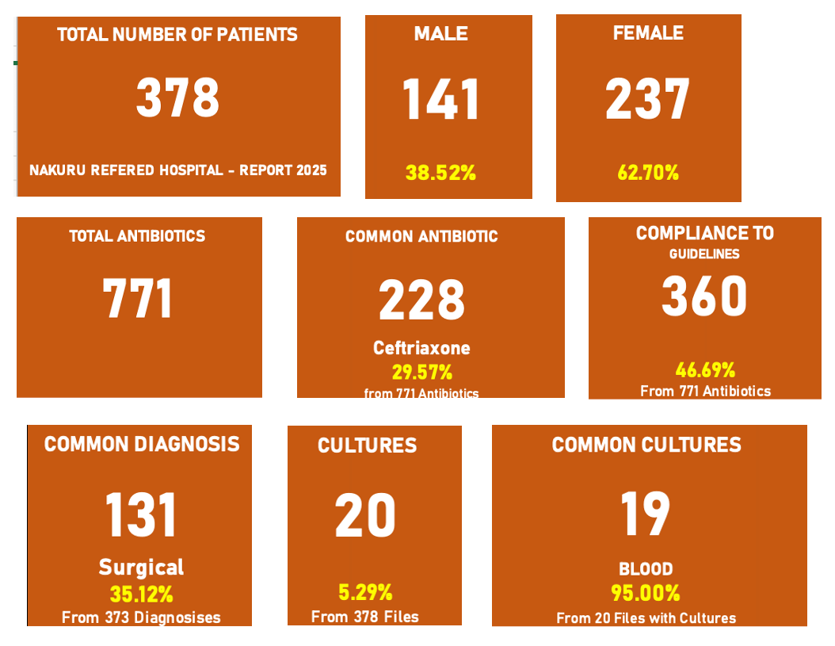
Key Findings – Retrospective patient file reviews

Slide 7
Key Findings – Retrospective patient file reviews…
Antibiotic de-escalation - primarily undocumented or unclear in 78% of cases, only 4% were guided by laboratory data
The ICAT laboratory assessment yielded moderate scores (75–77%) but identified critical weaknesses, including stock-outs and outdated antibiograms

Slide 8
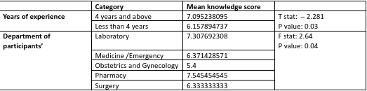


Key Findings – KAP survey
Healthcare workers exhibited fair knowledge of AMS principles (mean scores: 6.68–7/10)
17.8% of participants had an overall knowledge score of more than 8 out of 10
Years of experience, as well as the department, were statistically significant related to knowledge
Notes:
A total of 10 questions under knowledge.
We had 90 responses from NCRTH staff.

Slide 9
Key Findings – Economic evaluation
Antibiotic treatment costing and analysis considered:
        Antibiotic administration
        Incorrectly administered
        Correctly administered
        Misused antibiotics
        Cost of antibiotic – specific*

Slide 10
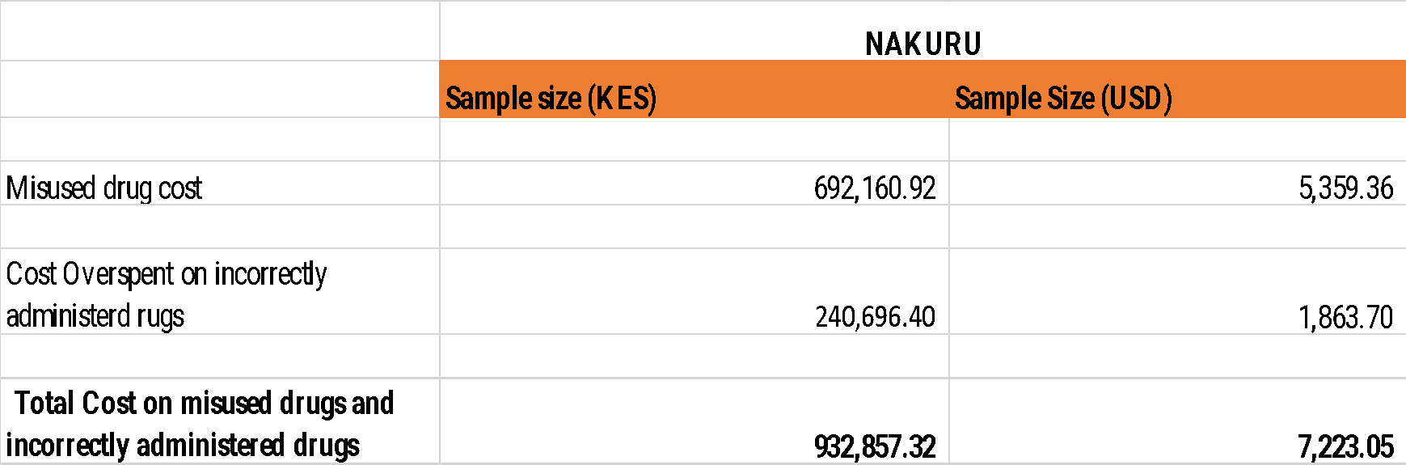
Key Findings – Economic evaluation
Analysis demonstrates substantial financial losses of $7,223.05 annually
The estimated drug cost per patient associated with such misuse was approximately USD 34.77

Slide 11
RECOMMENDATIONS
Strengthen AMS program at the facility
Train healthcare workers on AMS
Induction training for new staff to include AMS principles
Regular multidisciplinary AMS ward rounds
Pharmacy audits/prescription audits and feedback
Promote utilization of the microbiology lab
Strengthen microbiology lab capacity - equipment, reagents, supplies
Strengthen clinician – lab – pharmacy interface
Establish hospital antibiogram (with regular updates)

Slide 12
RECOMMENDATIONS…
Strengthen guideline compliance
Facility wide dissemination of antibiotic use guidelines
Routine audits of guideline compliance
Enhance proper documentation on antibiotic indications
Promote regular availability of key antibiotics
Accurate quantification of key antibiotics including buffer stocks
Allocation of adequate funds towards procurement of antibiotics
Procurement planning and supply planning ensure regular availability of the antibiotics

Slide 13
Interventions
Appointment of AMS champions in all departments with TORs
Revision of treatment sheets – facilitates proper documentation of antibiotic indications, antibiotic reviews every 48 – 72hours
Monthly departmental CMEs on the National antibiotic use guidelines
Revision of the facility antibiotic use policy based on AWaRe categorization
AMS ward rounds
Microbiologist part of AMS champions to boost utilization of the lab
Availability of lab reagents, culture bottles & antibiotic discs

Slide 14
ACKNOWLEDGEMENT
NCRTH AMS Committee
NCRTH Leadership
Department of Health Services – County Government of Nakuru
LifeArc Team
ReAct Africa Team

Slide 15
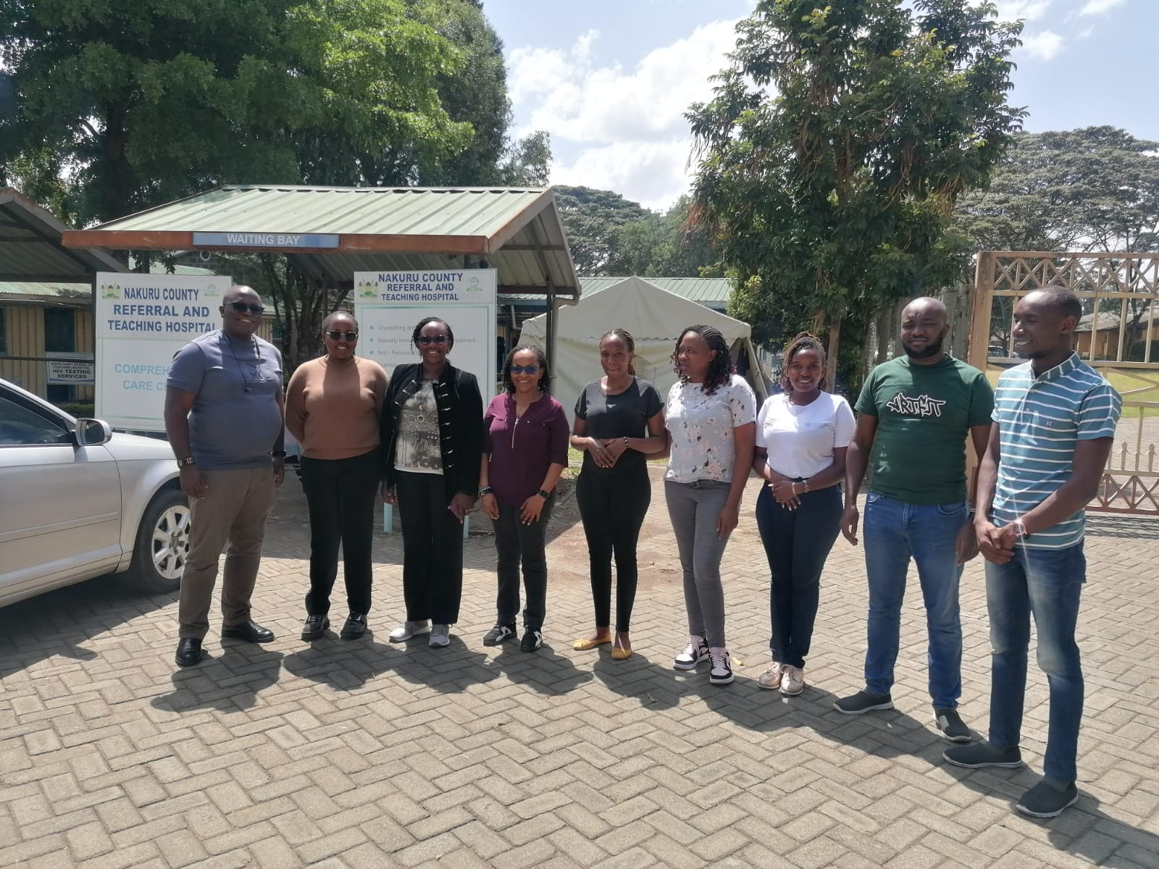


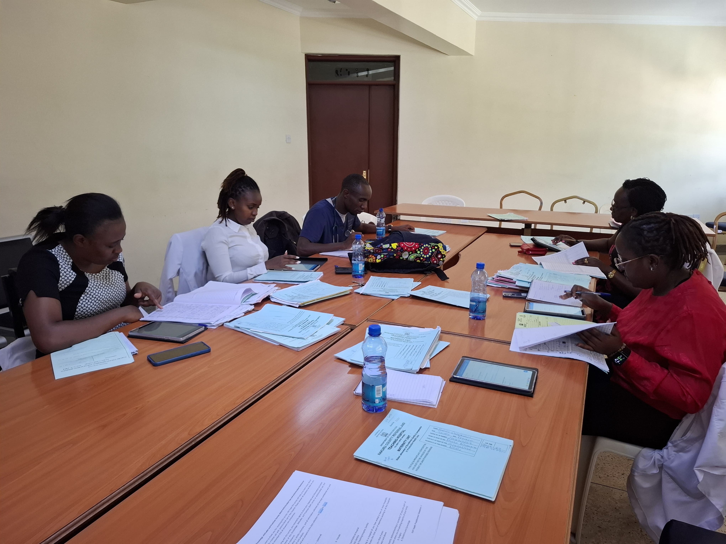

Slide 16
ASANTENI

